Slide 1
Recap
Unstructured content is increasing so is commercialization (market cap) of such content
IR is a science of finding material (documents) of unstructured nature that satisfies some information need within large collections
Search engines are the Key to the knowledge kingdom
Role of paid search
Search wars – conventional and new set of players
History/Evolution of Search engines

Slide 2
Evolution of Search Engines
Crawling and Indexing
Topic directories
Clustering and Classification
Hyperlink analysis
Resource discovery and vertical portals
Semantic Web
???
Notes:
https://en.wikipedia.org/wiki/Web_search_engine
after WWW invented by Sir Tim Breneners-Lee, no automated search before Sep 1993. Everything is indexed by hand and the list of web servers is hosted on CERN web servers. New servers are listed under “What’s New” section.
However,
1990 First tool to (as opposed to people) to search web is: Archie (variation of Archive) by students of CS (McGill University, Canada)
later on Veronica and Jughead are invented
June 1993 – first web robot – World Wide Web Wanderer created Index known as Wandex (MIT)
Nov 1993 – 2nd web search AliWeb
1994 –WebCrawler – first text based search engine – allowed search with any word
1994 Lycos (CMU) – first major commercial search engine
Other major search engines: Excite, Inktomi, Alta Vista, Northern Light, Info Seek
1994 – Yahoo search – first major successful search - web directory
1998 – Google
1993-1995 new set of search engines – Lycos (CMU)
Jerry Yang, Founder of Yahoo started playing with keeping various websites under topics/categories on his home page along with David Filo (other co-founder of Yahoo)

Slide 3
information retrieval cycle
Source
Selection
Resource
Query
Formulation
Query
Search
Results
Selection
Documents
System discovery
Vocabulary discovery
Concept discovery
Document discovery
Examination
Information
source reselection
Delivery
Notes:
Volume of data, diversity of the corpus, veracity, Speed, performance, engineering and implementation – these are the factors that would separate IR from other NLP tasks.

Slide 4
The central problem in search
Author
Searcher
Concepts
Concepts
Query Terms
Document Terms
“tragic love story”
“fateful star-crossed romance”
Do these represent the same concepts?
Notes:
Why is IR hard? Because language is hard!

Slide 5
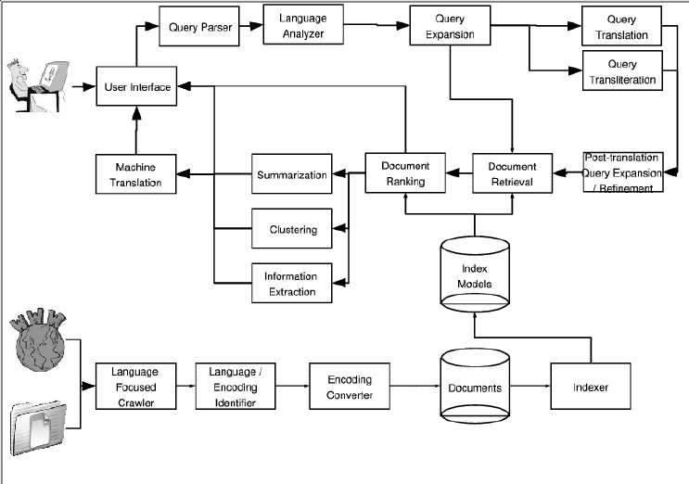
Notes:
5

Slide 6
abstract ir architecture
Documents
Query
document acquisition (e.g., web crawling)
online
offline
Representation
Function
Representation
Function
Query Representation
Document Representation
Index
Comparison
Function
Hits

